Slide 1
Software Engineering
Function Points

Slide 2
Function point metric
Can be used effectively as a means for measuring the functionality delivered by a system.
Using historical data, the FP can then be used to
  Estimate the cost or effort required to design, code, and test the software
  Predict the number of errors that will be encountered during testing, and
  Forecast the number of components and/ or the number of projected source lines in the implemented system.

Slide 3
Function point metric
Function points are derived using an empirical relationship based on countable (direct) measures of software's information domain and assessments of software complexity

Slide 4
Function point metric
Information domain values are defined in the following manner:
  number of external inputs (EIs)
  number of external outputs (EOs)
  number of external inquiries (EQs)
  number of internal logical files (ILFs)
  Number of external interface files (EIFs)

Slide 5
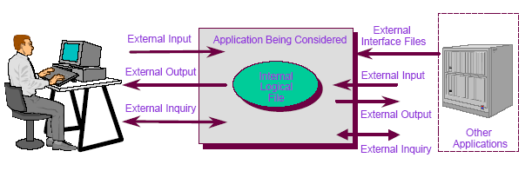
What is Function Point?

Slide 6
Steps in FP Counting
• Determine Type of Count
• Identify Counting Scope and Application Boundary
• Count Data Functions
• Count Transactional Functions
• Determine Unadjusted Function Point Count
• Determine Value Adjustment Factor
• Calculate Adjusted Function Point Count

Slide 7
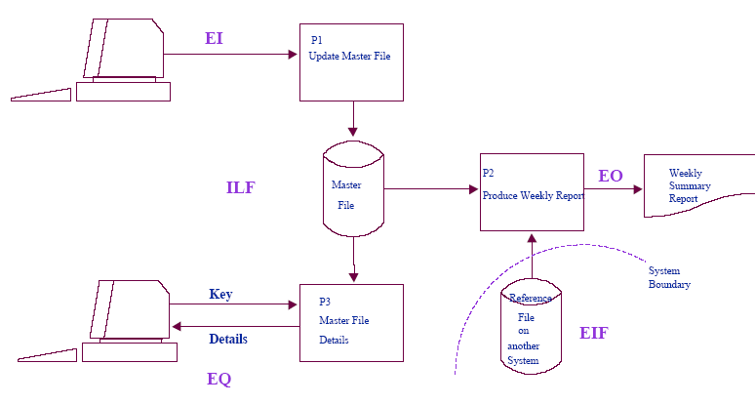
FP Overview: What Is Counted

Slide 8
The Five Components of Function Points
Data Functions
Internal Logical Files
External Interface Files
Transactional Functions
External Inputs
External Outputs
External Inquiries

Slide 9
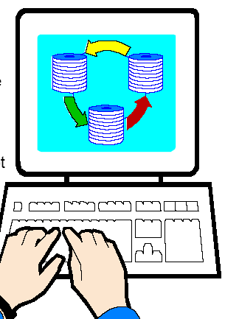
Data Storage
Internal Logical File (ILF)
  Logical group of data maintained by the application (e.g., Employee file)
External Interface File (EIF)
  Logical group of data referenced but not maintained (e.g., Global state table)

Slide 10

Transactions
External Input (EI)
those items provided by the user that describe distinct application-oriented data (such as file names and menu selections)
External Output (EO)
those items provided to the user that generate distinct application-oriented data (such as reports and messages, rather than the individual components of these)
External Query (EQ)
Formatted data sent out of application without added value

Slide 11
External
Input
External
Output
External
Inquiry
Internal
Logical File
External
Interface File
External Input
External Output
Application Boundary
Other Applications

Slide 12
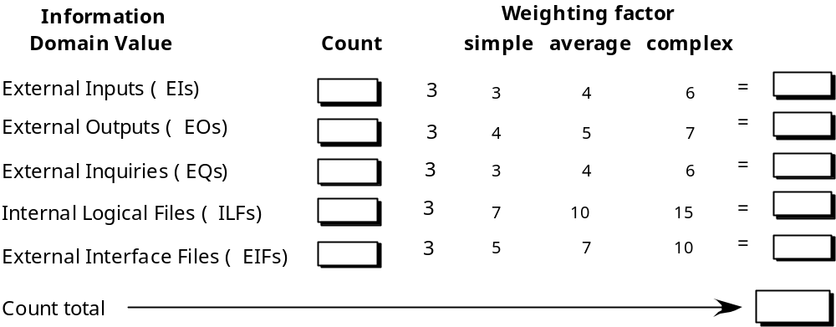
Functional Size
(Unadjusted Function Size)

Slide 13

Value Adjustment Factor
Based on 14 General System Characteristics (User
Business Constraints Independent of Technology)
– Examples: data communications, response
times, end user efficiency, multiple sites and
flexibility
• Adjusts FP count by up to + / - 35%

Slide 14
Function Point
Measure of the amount of functionality in a product
Can be estimated early in project before a lot is known.
Measure a software project by quantifying processing functionality associated with major external data or control input, output or file types

Slide 15
Computing Function Points - Step 1
Establish count for information domain values
  Number of User Inputs
  Number of User Outputs
  Number of User Inquiries
  Number of Files
  Number of External Interfaces (files)

Slide 16
Computing Function Points - Step 2
Associate complexity value with each count
Rate the function complexity for each identified function as
  Simple, Average, Complex
  Compute count total
Then count the function points for each function, depending on its complexity

Slide 17
Computing Function Points - Step 3
Calculate complexity adjustment values (F_{i}, where i∈[1..14])
  Does the system require reliable backup and recovery?
  Are data communications required?
  Are there distributed processing functions?
  Is performance critical?
  Will the system run in an existing, heavily utilised operating environment?
  Does the system require on-line data entry?
  Does the on-line data entry require the input transaction to be built over multiple screens or operations?
  Are the master files updated on-line
  Are the inputs, outputs, files or inquiries complex

Slide 18
Computing Function Points - Step 3
  Is the internal processing complex?
  Is the code designed to be reusable?
  Are conversion and installation included in the design?
  Is the system designed for multiple installations in different organisations?
  Is the application designed to facilitate change and ease of use by the user?
Answer Each Question using a scale of 0 (N/A) to 5 (Absolutely Essential)
Sum the 14 complexity adjustment values ΣF_{i}

Slide 19
Computing Function Points - Step 4
Calculate
0.65 and 0.01 are empirically derived constants
Should calculate weighted average of FPs also
FP = count total × (0.65 + 0.01×∑F_{i})

Slide 20
Reconciling FP and LOC
Most effort estimation models require LOC
Example:
  LOC/FP for C is estimated at 128 LOC
  LOC/FP for C++ is estimated at 64 LOC
  LOC/FP for Assembly is estimated at 320 LOC

Slide 21
Example
A data flow model for SafeHome Software:
  External inputs – password, panic button, and activate/deactivate (3)
  External inquires – zone inquiry and sensor inquiry (2)
  Internal logical file – system configuration file (1)
  External output – messages and sensor status (2)
  External Interface Files – test sensor, zone setting, activate/deactivate, and alarm alert (4)

Slide 22
Example

Slide 23
Example
Count total
Where count total is the sum of all FP entries.
Fi (I = 1 to 14) are value adjustment factor.
For this example we assume that VAF = 46
FP = 50 X [0.65 + (0.01 X 46)] = 56
FP = count total × (0.65 + 0.01×∑F_{i})

Slide 24
Function Point
Based on the projected FP value derived from the analysis model:
  The project team can estimate the overall implemented size of the safeHome user interaction function.
  Assume one FP translate 60 LOC (OOL is to be used)
  12FP are produced for each person-month of effort
  An average 3 errors/FP during analysis and design reviews
  4 errors/FP during unit and integration testing

Slide 25
One FP translate 60 LOC
56X60 = 3360 LOC or 3.360KLOC
12FP produced one person-month effort
56/12 = 4.67 ~ 5 person-month effort

Slide 26
Spell-Checker Specification
The checker accepts as input a document file and an optional personal dictionary file. The checker lists all words not contained in either of these files. The user can query the number of words processed and the number of spelling errors found at any stage during processing.
Errors Found
Spelling Checker
# Words processed message
User
Words processes enquiry
# errors message
User
Document file
Report on misspelled words
Personal dictionary
Dictionary

Slide 27
Spell-Checker Specification
The two external inputs: document filename, personal dictionary-name
The three external outputs: misspelled word report, number of words processed message, number of errors so far message
The two external inquiries: words processed, errors so far
The two external files: document file, personal dictionary
The one internal file: dictionary
A= # external inputs = 2
B= # external outputs = 3
C= # inquiries = 2
D= # external files = 2
E= # internal files = 1

Slide 28
Example

Slide 29
Example
Count total
Where count total is the sum of all FP entries.
Fi (I = 1 to 14) are value adjustment factor.
For this example we assume that VAF = 28
FP = 55 X [0.65 + (0.01 X 28)] = 51
FP = count total × (0.65 + 0.01×∑F_{i})

Slide 30
Table 2. Components of the technical complexity factor.
F1 | Reliable back-up and recovery | F2 | Data communications
F3 | Distributed functions | F4 | Performance
F5 | Heavily used configuration | F6 | Online data entry
F7 | Operational ease | F8 | Online update
F9 | Complex interface | F10 | Complex processing
F11 | Reusability | F12 | Installation ease
F13 | Multiple sites | F14 | Facilitate change
Each component is rated from 0 to 5, where 0 means the component has no influence on the system and 5 means the component is essential (Pressman, 1997). The Technical Complexity Factor TCF can then be calculated as:
TCF = 0.65 + 0.01(SUM(Fi))
The factor varies from 0.65 (if each Fi is set to 0) to 1.35 (if each Fi is set to 5) (Fenton, 1997). The final function point calculation is:
FP = UFC x TCF

Slide 31
Language SLOC per Function Point
Language | LOC | Language | LOC
1GL Default Language | 320 | 2GL Default Language | 107
3GL Default Language | 80 | 4GL Default Language | 20
Access | 35 | Assembler | 62
C | 337 | C++ | 162
COBOL | 77 | Excel | 46
Java | 63 | JavaScript | 58
JSP | 59 | Oracle | 30
Perl | 60 | RPG II/III | 61
Smalltalk | 26 | SQL | 40
VBScript | 36 | Visual Basic | 47
Java = 51 x 63
= 3.213 KLOC

